Slide 1
NLP Demos
Tuesday December 16th | Friday December 19th
8:30-9:00 Marin Janushaj, Yunus Eren Ertas 9:00-9:30 Ravin Shalmashi, Paschal Chukwubuikem Ifewulu, Martin Zhelyazkov | 8:30-9:00 Natan Wojtowicz, Tijl Cleynhens,Tuur Mentens 9:00-9:30 Mateo Donado González, Núria Padilla Sánchez, Alexander Hoegen-Jupp 9:30-10:00 Julia Drygalska, Pierina Lopez BREAK 10:30-11:00 Renzo Schreppers, Sander Wijns, Tiebe Goossens 11:00-11:30 Iljas Leys, Thomas Van Sande | 11:30-12:00 Alex Hendrickx, Mauro Leonardo, Brent Paessens LUNCH 13:00-13:30 Ibrahim Afkir, Hamid Iqbal 13:30-14:00 Jo Naulaerts, Abdul Salam Aldabik 14:00-14:30 Neila Fekovic, José Gutiérrez Montero, Tymo Verhaegen

Slide 2


Slide 3
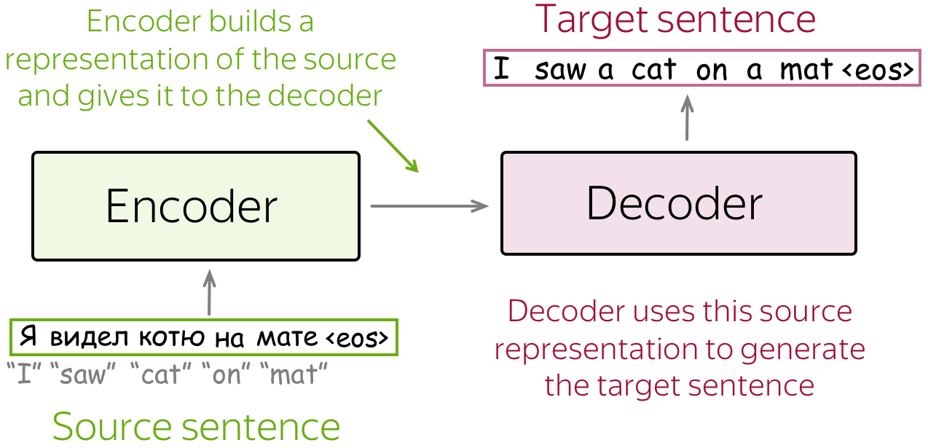
Encoder-Decoder for Seq2Seq
Notes:
https://lena-voita.github.io/nlp_course/seq2seq_and_attention.html
Several language tasks require turning one sequence into another: seq2seq
Input or source sentence, output or target sentence
An encoder: creates a representation of the input
A decoder: generates output using that representation
The encoder network “listens,” processes all input tokens, and encodes them. The decoder network “speaks,” generating the output tokens one by one.

Slide 4
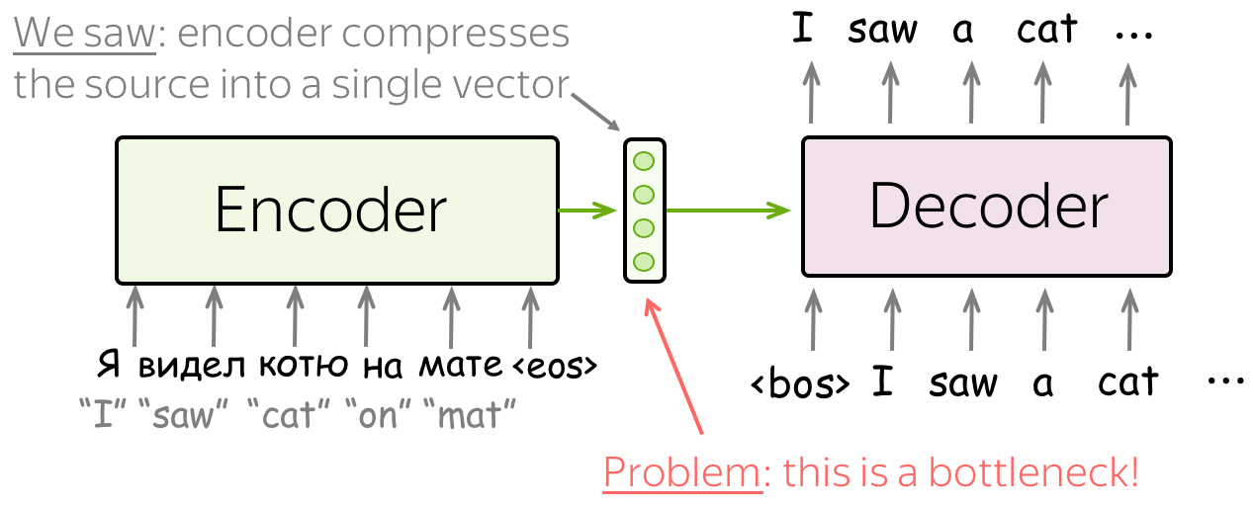
Bottleneck in Seq2Seq without Attention
The final hidden state of the encoder tries to compress the whole input sentence into one fixed-length context vector
When dealing with long sentences we lose information resulting in an information bottleneck
Notes:
The final hidden state tries to compress the whole input sentence into one vector → too small
Long sentences lose information → translations (or summaries, answers, …) become inaccurate
Even LSTMs struggle with this compression
Issue of both RNN and BRNN encoder
Furthermore, the output sequence depends heavily on the hidden state of the final RNN cell of the encoder. The encoder’s state is only passed to the first RNN cell of the decoder and with every time step information from the encoder disappears such that later timesteps have much less access to the encoder information. This makes it also difficult for the model to deal with long sequences.

Slide 5
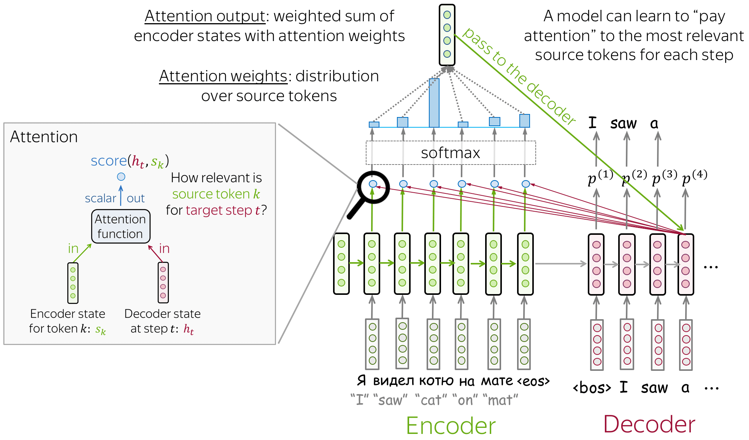
Seq2seq with Attention
Notes:
Without attention: the decoder receives only the final encoder hidden state as the context vector
This compresses all input information into one fixed-length context vector resulting in an information bottleneck
With attention: the decoder has access to all encoder hidden states
At each timestep, it computes a new context vector focused on the most relevant parts of the input
This allows dynamic, flexible use of input information and improves performance on long or complex sequences
Attention function = how we compute attention scores.
You can apply any function you want. Function measures how related or similar the words are.
The most popular ways to compute attention scores are:
dot-product - the simplest method;
bilinear function (aka "Luong attention") multi-layer perceptron (aka "Bahdanau attention")

Slide 6
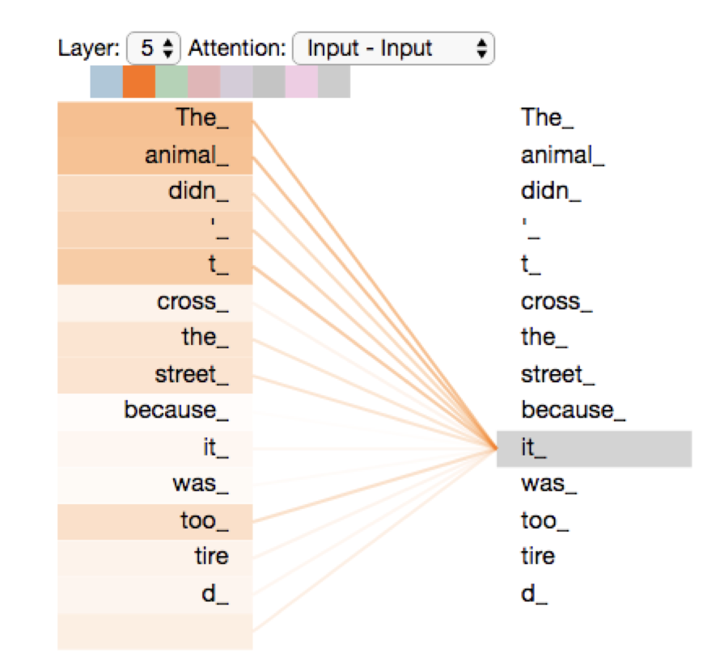
From Cross-Attention to Self-Attention
Cross-attention introduced a powerful idea: allowing each token from the output sequence to look at any token from the input sequence to learn the mapping from input to output
More powerful than the recurrent structure around it!
Self-attention allows each token in a sequence to look at all other tokens in the same sequence to decide which ones are most relevant for understanding its meaning
Notes:
Difference with attention in seq2seq:
not between tokens of two sequences but between tokens of the same sequence
Not for task learning but for representation learning

Slide 7
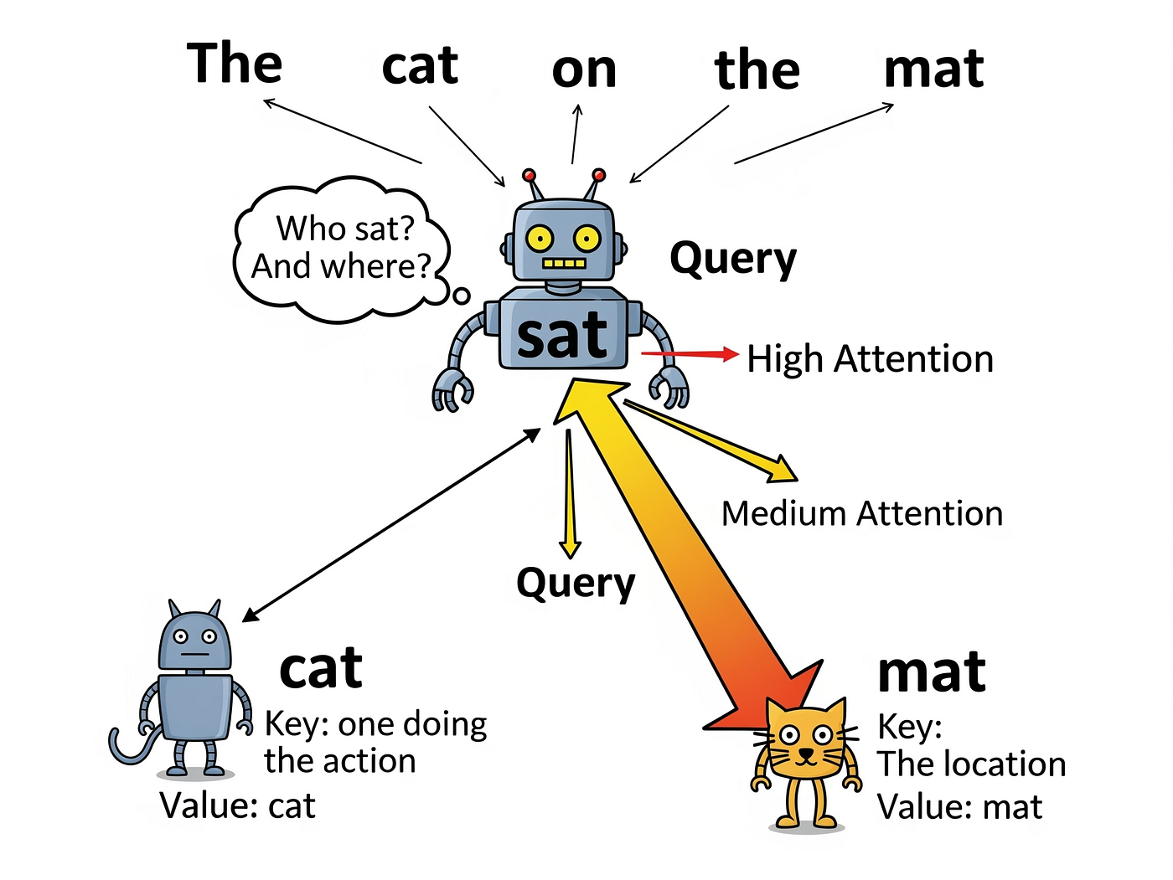
Self-Attention
Each token takes on 3 roles in self-attention:
Query: What information is this word looking for? (question)
Key: What information does this word contain? (label)
Value: The actual content that is passed to other words (information)
Self-attention assigns attention weights (higher for more relevant words)
The token’s new embedding becomes a weighted combination of all the words it attends to
Notes:
https://medium.com/@anagharamdas2000/a-beginners-guide-to-the-logic-of-transformers-powering-modern-ai-e21be8b02286
Each token takes on 3 roles to compute self-attention, in which every token embedding is transformed into three embeddings (one for each role), Query: represents what information this word is looking for Key: represents what information this word contains Value: represents the actual content that is passed to other words when they attend to it
Instead of passing information step by step like in an LSTM, self-attention connects every token directly to every other token in a single operation
Captures long-range syntax (e.g., subject–verb agreement) and semantic relations (e.g., coreference).

Slide 8
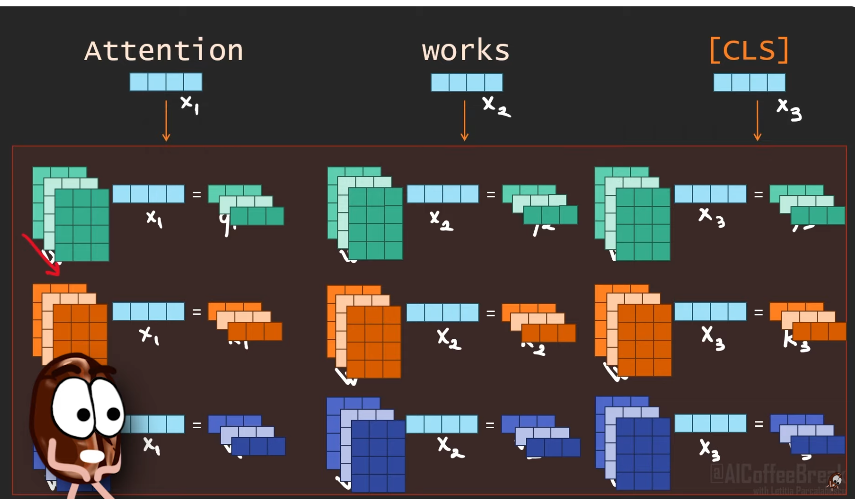
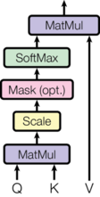
Multi-Head Self-Attention
Multi-head self-attention replaces recurrence with direct, parallel connections between all words, allowing the model to capture both syntactic and semantic relationships across any distance
Notes:
Multi-head self-attention is applied across many layers of a transformer, with each head and layer capturing different aspects of language
Lower layers: Learn local linguistic features such as basic morphology and part-of-speech cues
Middle layers: Integrate information from multiple heads to capture syntactic structures, phrase boundaries, and short-range dependencies
Higher layers: Learn global, abstract features, including context-dependent word meaning, long-range relationships, and semantic or conceptual patterns
This layered, multi-head architecture allows to build a hierarchical understanding of language

Slide 9
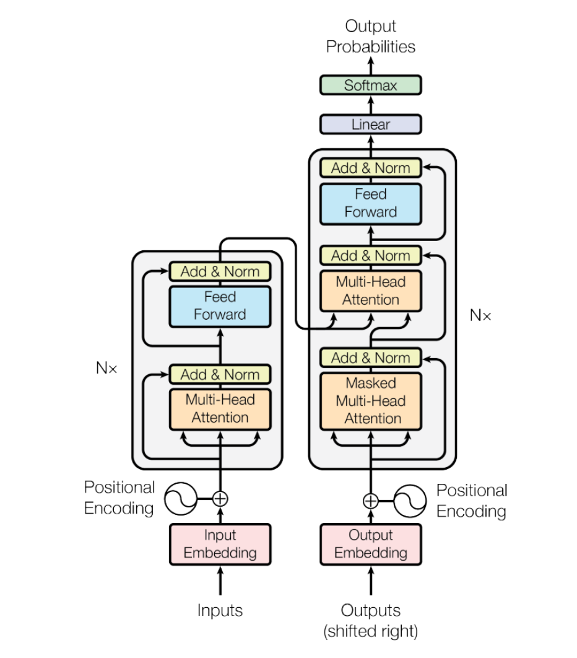
Transformer Architecture
Transformer is an encoder-decoder architecture for seq2seq tasks that no longer uses recurrent layers
Core components are:
Self-attention operates between source tokens (in the encoder) or between target tokens (in the decoder) to capture context and meaning for representation learning
Feedforward layers process each token’s contextualized representation independently and refine and update its meaning using the model’s learned general linguistic knowledge
Cross-attention operates between each target token and all source tokens to align input and output sequences for task learning
Notes:
Self-attention shares information across the sequence.
By combining attention with feedforward layers, the Transformer processes sequences efficiently and without recurrence in a fully parallelizable way.

Slide 10
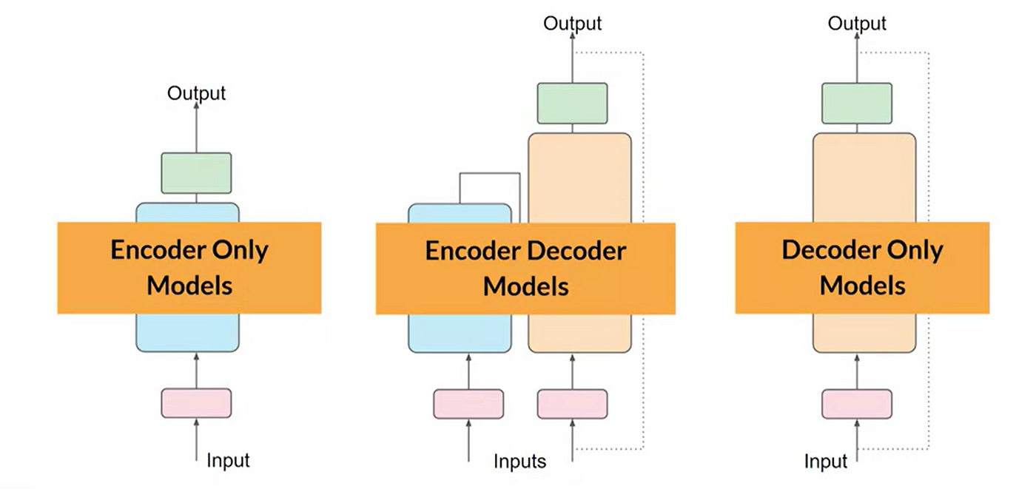
Three types of Transformer LLMs
The original Transformer was built for seq2seq tasks (like translation), using an encoder–decoder structure with self-attention and cross-attention
However not all NLP tasks require both components, leading to three main architectural variants:
Notes:
Encoder-only: Language understanding tasks (e.g. BERT)
Encoder-decoder: Seq2seq tasks (e.g. T5 or BART)
Decoder-only: Language generation (e.g. GPT)

Slide 11
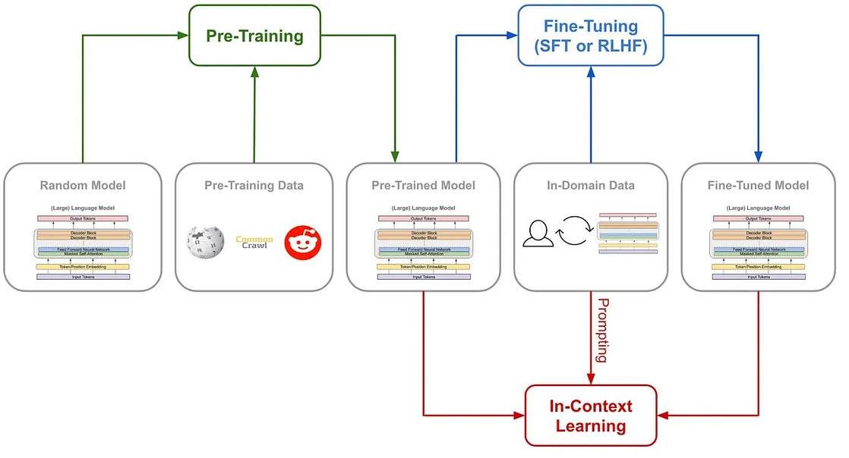
Pre-training vs Fine-Tuning vs In-Context Learning
Notes:
https://medium.com/@bijit211987/the-evolution-of-language-models-pre-training-fine-tuning-and-in-context-learning-b63d4c161e49

Slide 12
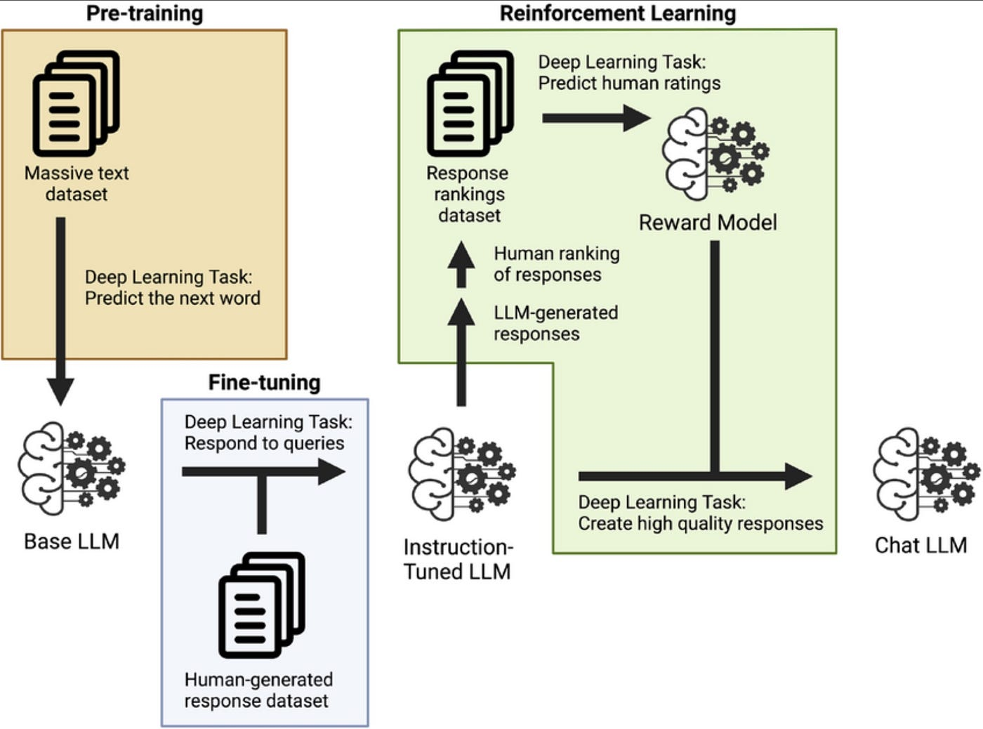
RLHF Reinforcement Learning from Human Feedback
Notes:
Reinforcement Learning from Human Feedback (RLHF)
Builds on instruction tuning.
Human evaluators rank or score model responses to prompts.
A reward model is trained on those rankings, and the base model is fine-tuned to maximize that reward using reinforcement learning

Slide 13
Deep Learning
Natural Language Processing (NLP)
Multimodal Transformers

Slide 14

Lesson Goals
Vision Transformers: Students can explain how ViTs adapt the Transformer architecture to image data by treating image patches as tokens, describe how self-attention models long-range spatial relationships, and understand why ViTs require large-scale pretraining but offer strong scalability and flexibility compared to CNNs.
Multimodal Transformers: Students can describe how multimodal Transformers process and integrate information from different modalities, explain how models combine visual and textual inputs to produce joint representations, and compare major architectural approaches such as single-stream models (e.g., VisualBERT), dual-stream models (e.g., ViLBERT), contrastive dual-encoder models (e.g., CLIP), and fusion-generative models (e.g., BLIP, BLIP-2).
Multimodal Representation Learning: Students will understand how multimodal models learn shared embedding spaces that align visual and textual concepts, explain how self-supervised pretraining objectives support the learning of this alignment, and recognize how such shared spaces enable cross-modal retrieval tasks.

Slide 15
Connecting Vision and Language

Slide 16
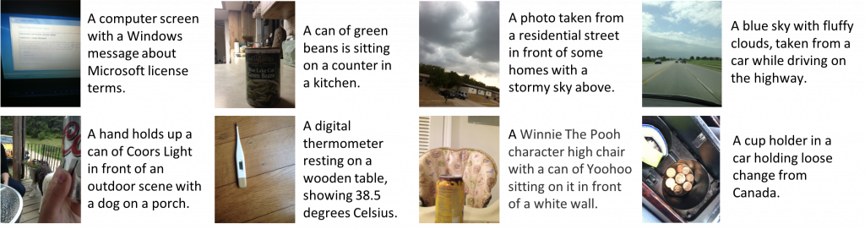
Connecting Vision and Language
Although vision and language seem different, they are two ways of representing the world
Language describes the world through words, which are discrete and symbolic
Vision describes the world through pixels, which are continuous and spatial
Notes:
https://vizwiz.org/tasks-and-datasets/image-captioning/
Discrete vs. Continuous
Discrete data can only take on specific, separated values, while continuous data can take on any value within a defined range or interval.
Discrete (language): Words are separate units—“cat,” “runs,” “tree”—each clearly distinct from the others.
Continuous (vision): Images are made of pixels whose values vary smoothly, forming gradients of color and intensity without clear unit boundaries.
Symbolic vs. Spatial
Symbolic (language): Words are symbols that represent meaning; their position in a sentence is important, but the symbols themselves do not occupy physical space.
Spatial (vision): Pixels are arranged in a 2D grid where meaning comes from spatial structure—shapes, edges, textures, and their relative positions.

Slide 17
Connecting Vision and Language
For a long time, vision and language required very different neural network architectures:
Vision used CNNs CNNs relied on convolutional filters to capture local patterns (edges, textures, shapes) in images
Language used RNNs / LSTMs RNNs processed text sequentially, capturing temporal and linguistic dependencies across tokens
These differences seemed fundamental until the attention mechanism changed everything

Slide 18
Connecting Vision and Language
Attention can learn relationships between different parts of the input directly
Not limited by local context (as in RNNs) or local receptive fields (as in CNNs), it can capture dependencies between any two parts of an input, no matter how far apart
Attention can mimic both convolution and recurrence
This flexibility removes the architectural constraints of CNNs and RNNs
Attention scales better than CNNs and RNNs
Attention processes everything in parallel and captures global context in one step
Transformers unify processing across vision and language
Notes:
Attention made a unified architecture possible
1. Attention can learn relationships between segments directly
Unlike RNNs, attention does not need to process data step-by-step. Unlike CNNs, attention is not limited to local receptive fields. It can capture dependencies between any two parts of an input, no matter how far apart.
2. Attention can mimic both convolution and recurrence
With the right learned patterns, attention heads can behave like convolution filters, focusing on local neighborhoods of an image.
Other heads can behave like long-range RNNs, tracking dependencies across entire sentences or images. This flexibility removes the architectural constraints of CNNs and RNNs.
3. Attention scales better than CNNs and RNNs
RNNs cannot be parallelized (slow).
CNNs require deep stacks to capture long-range interactions (inefficient).
Attention processes everything in parallel and captures global context in one step.
4. Transformers unify processing across modalities
Because attention works on sequences of embeddings, and images can be converted into sequences of patch embeddings, the same architecture can process both text and images.
Thus, the idea of visual words naturally emerges.

Slide 19
Vision Transformers

Slide 20
Words vs. Visual Words
Words and pixels look very different, yet both describe the same underlying world
We use words to refer to objects, actions, and attributes
In images, these same objects, actions, and attributes appear as contiguous regions of pixels
We can think of these regions as visual words: patches of the image that play a similar role to tokens in a sentence
Notes:
Language describes the world through words, which are discrete and symbolic. Vision describes the world through pixels, which are continuous and spatial.
Even though words and pixels look very different, both describe the same underlying world.

Slide 21
Words vs. Visual Words
In language, we tokenize text into words or subwords and embed them
In vision, an image can be divided into fixed-size patches and treated as visual words
Each patch is flattened and projected into a patch embedding vector, just like a word embedding
The visual words become the input of the Vision Transformer so images are processed as sequences of patch embeddings
Positional encodings inject spatial order
A learnable [CLS] token summarizes the entire image, just like in BERT
Notes:
In NLP, we tokenize text into words or subwords and embed them. Similarly, in Vision Transformers (ViTs), an image is divided into fixed-size patches, each treated like a “token.”
Each patch is flattened and projected into a patch embedding vector, just like a word embedding.
The sequence of patch embeddings becomes the ViT input so images are processed as sequences, just like sentences.
A learnable [CLS] token summarizes the entire image, just like in BERT.
Positional encodings inject spatial order, since self-attention is permutation-invariant.
ViTs Treat Images as Sequences
This is key to connecting them back to NLP:
No convolution
No recurrence
Pure sequence modeling

Slide 22
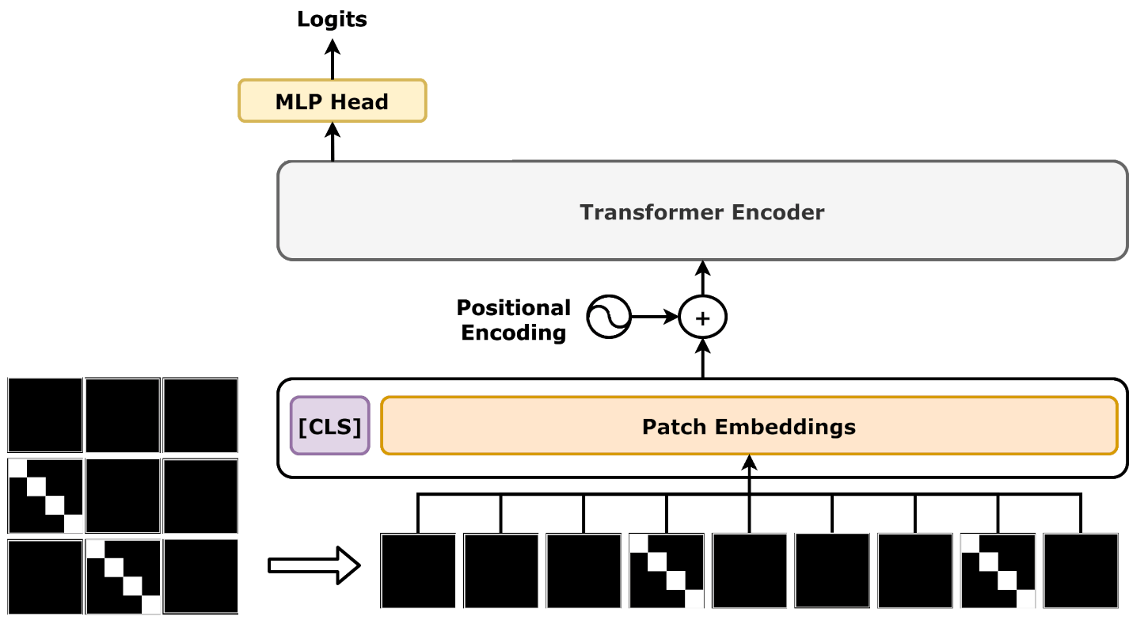
Vision Transformers (ViT) Patches, Position Embeddings, CLS token
Final embedding of [CLS] token becomes the image-level representation used for classification
Positional embeddings help preserve spatial structure
Notes:
Patch + Position Embeddings Are Crucial
ViTs flatten patches and add learned positional embeddings to preserve spatial structure. Without positional information, self-attention would treat patches as an unordered set.
A Learnable [CLS] Token Summarizes the Entire Image
Just like in BERT, ViTs prepend a [CLS] token whose final embedding becomes the image-level representation used for classification tasks.

Slide 23
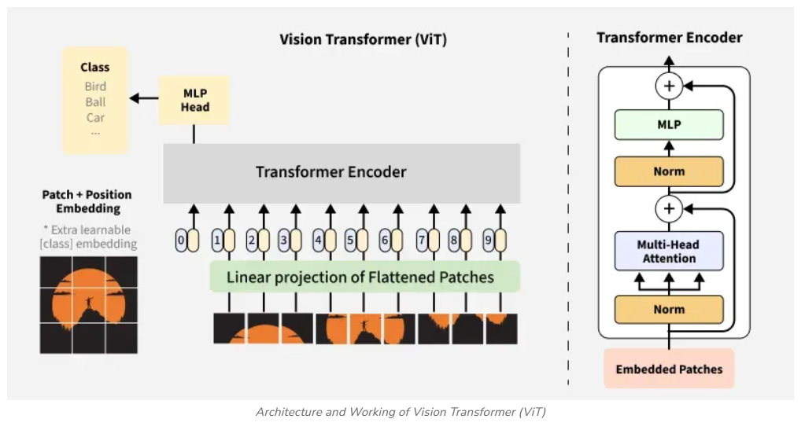
Vision Transformers (ViTs) Architecture
Notes:
https://www.geeksforgeeks.org/deep-learning/vision-transformer-vit-architecture/

Slide 24
Vision Transformers (ViTs) Architecture
A Vision Transformer is an encoder-only Transformer
Self-attention layers allow every patch to attend to every other patch, capturing global relationships across the image
A feedforward network refines each patch representation
A final MLP classification head uses the CLS token (which aggregates information from all patches) to predict the image class
Notes:
MLP = Multilayer Perceptron

Slide 25
Vision Transformers (ViTs) Training and Performance
CNNs have strong inductive biases (local patterns, translation invariance), making them data-efficient
ViTs lack these biases and must learn visual structure from scratch
Therefore, ViTs require large datasets, or strong regularization, or large-scale pretraining
Self-attention is not limited to local receptive fields, so ViTs can model global spatial relationships from the first layer
They generalize well across different tasks
Their performance improves rapidly as model and dataset sizes increase, and at large scale they surpass CNNs
Notes:
CNNs have strong built-in inductive biases:
They assume local patterns are important (via convolution).
They assume translation invariance (same filters everywhere).
They focus on local receptive fields early on.
These assumptions make CNNs very data-efficient — they don’t need to learn these properties from scratch.
ViTs, however, do not have these biases:
They do not assume locality.
They do not assume translation invariance.
They must learn these fundamental visual properties from data.
Because ViTs start with fewer assumptions, they need:
more data, or stronger regularization, or pretraining on massive datasets.
Self-attention is not restricted to local neighborhoods like convolutions are. This means ViTs can:
capture global relationships between distant image regions immediately
adapt more easily to different kinds of visual tasks
improve strongly as model size grows (better scaling laws)
When you have huge datasets, big models, and sufficient compute, Vision Transformers outperform CNNs.
At small/medium scale, CNNs may still be competitive because their inductive biases make them data-efficient

Slide 26
Multimodal Transformers

Slide 27
Multimodal Transformers
Transformers that process text tokens learn linguistic relations through multi-head self-attention, forming a latent embedding space where geometry reflects semantic similarity
Vision Transformers use multi-head self-attention to learn spatial relations between image patches, producing a latent embedding space that captures visual semantic similarity
Since both vision and language describe the same underlying world (i.e. objects, actions, and attributes) there are meaningful relations between text tokens and image patches as well
Because Transformers can process both word tokens and image patch tokens, nothing prevents us from feeding them together into a shared model

Slide 28
Multimodal Transformers
Multimodality means integrating or combining information from multiple sources or sensory modalities
Common modalities include text, images, audio, video, and sensor data
Multimodal Transformers combine modalities (e.g., vision and language) and learn:
Modality-specific representations such as patch embeddings and token embeddings
A shared or aligned representation space that aligns semantically related text tokens and image patches
Cross-modal reasoning which supports multimodal tasks
Notes:
What Is Multimodality?
Multimodality means integrating information from multiple sources or sensory modalities.
Common modalities include text, images, audio, video, and sensor data.
What Multimodal Models Must Learn
Multimodal Transformers combine modalities (e.g., vision and language) and learn:
Modality-specific representations
Examples: patch embeddings for images, token embeddings for text.
A shared or aligned representation space
Aligns semantically related text tokens and image patches.
Enables cross-modal matching (e.g., “dog” ↔ region of a dog in an image).
Cross-modal reasoning
Supports multimodal tasks such as:
image captioning
visual question answering
image–text retrieval
multimodal reasoning and understanding

Slide 29
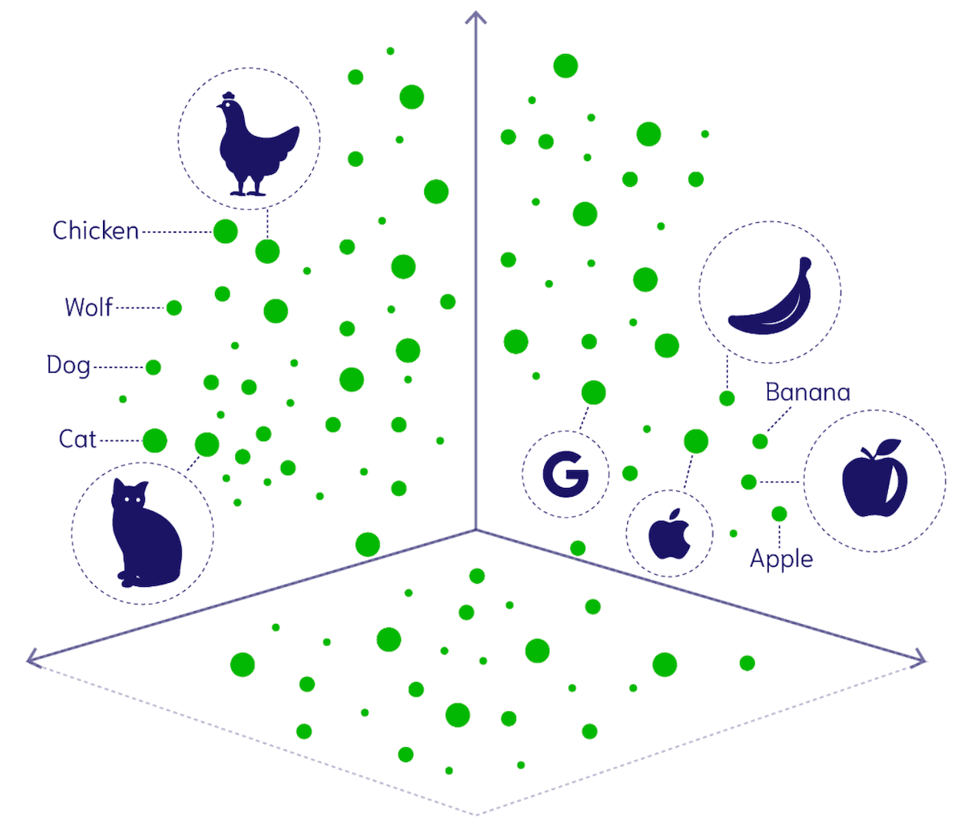
Multimodal Representation Learning
Multimodal representation learning is the process of mapping different modalities (e.g., text and images) into a shared embedding space so that semantically related elements from each modality are close together
Notes:
Multimodal Representation Learning
Multimodal representation learning is the process of mapping different modalities (e.g., text and images) into a shared or aligned embedding space so that semantically related elements from each modality are close together.
So when multimodal transformers learn:
token embeddings (text)
patch embeddings (vision)
and place them in the same latent space
https://weaviate.io/blog/multimodal-models

Slide 30
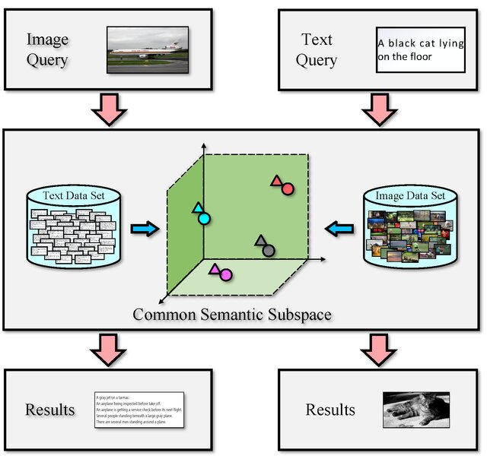
Cross-modal Retrieval
Cross-modal retrieval means using
an image to find relevant texts (image-to-text retrieval)
a text to find relevant images (text-to-image retrieval)
It requires the model to learn consistent, comparable embeddings across modalities

Slide 31
ViLBERT Vision-and-Language BERT
Multimodal Transformers need mechanisms that let text and images interact with each other
ViLBERT achieves this by using two Transformer streams: one for vision and one for language
These streams are connected through co-attention layers, enabling deep cross-modal alignment
Notes:
Hence ViLBERT is a two-stream model with separate encoders for text and images and cross-attention to fuse the modalities.

Slide 32
ViLBERT Input
A tokenizer is used to split sentences into subwords which are then converted into token embeddings or text tokens
Faster R-CNN is used to obtain bounding boxes around meaningful object regions and extract region-level embeddings. These region embeddings are then treated as visual tokens
Notes:
A tokenizer is used to split sentences into tokens It breaks text into smaller units (words, subwords, or characters), which can then be converted into embeddings for processing by a Transformer.
Faster R-CNN is used to obtain bounding boxes around object regions and extract region-level embeddings It identifies meaningful regions in an image (objects or attributes) and produces a feature vector for each region. These region embeddings are then treated as visual tokens and fed into multimodal Transformers just like text tokens.

Slide 33
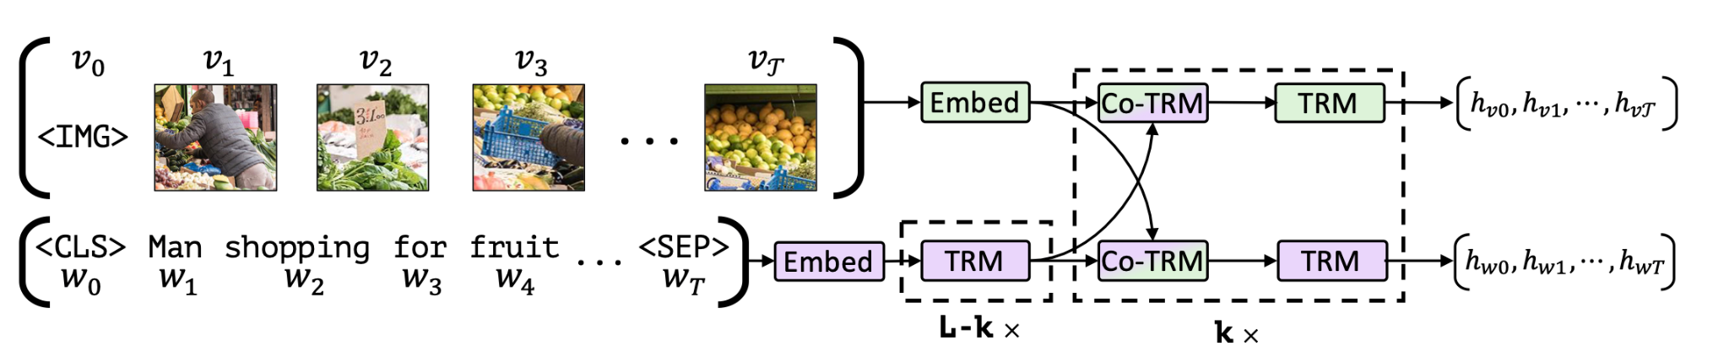
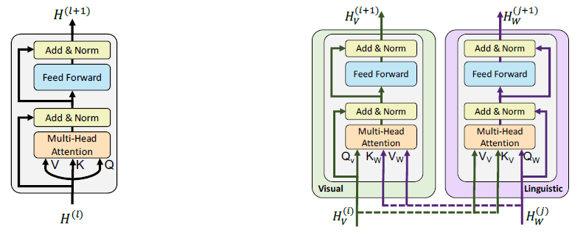
ViLBERT Architecture
Notes:
Accommodates the differing processing needs of each modality
Enables interaction between modalities at varying representation depths

Slide 34
ViLBERT Architecture
Two separate Transformer encoders:
One for processing text tokens
One for processing image patches
Co-attention (bidirectional cross-attention) layers, which enable:
Token embeddings to attend to patch embeddings at varying representation depths
Patch embeddings to attend to token embeddings at varying representation depths
This architecture allows the model to learn rich interactions between the two modalities while keeping each encoder specialized
Notes:
Accommodates the differing processing needs of each modality
Enables interaction between modalities at varying representation depths

Slide 35
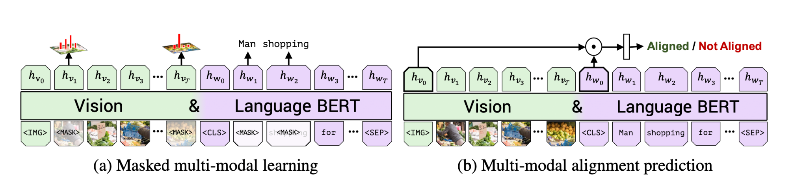
ViLBERT Two pretraining objectives
ViLBERT is pretrained with two self-supervised objectives:
Masked multimodal learning (predicting masked text and regions using both modalities)
Multimodal alignment (determining whether text and images correspond)
Notes:
1. Masked Multimodal Learning (Text and Image Regions)
ViLBERT masks:
some text tokens
some image regions (objects/features)
and the model must predict the masked content using both modalities. This forces the model to jointly use visual and linguistic context — not just one or the other.
This objective includes:
Masked Language Modeling (MLM) conditioned on visual features
Masked Region Classification (MRC) conditioned on text
Together, this is often described as masked multimodal learning.
2. Multimodal Alignment Objective
This task trains ViLBERT to determine whether the image and text match (i.e., belong together) or are mismatched. This objective teaches the model:
how to align image regions with relevant text
how to identify cross-modal correspondences
how to perform joint reasoning across modalities
This alignment loss is crucial for tasks like retrieval and VQA.

Slide 36
ViLBERT Pretraining and finetuning
During pre-training, we learn general, task-agnostic multimodal embeddings from a large-scale image–text dataset
Conceptual Captions is a collection of ~3 million of image-caption pairs automatically derived from alt-text enabled web images
Large-scale data is needed for several reasons:
ViTs have weaker inductive biases.
Multimodal alignment requires broad visual and linguistic coverage
Afterwards, the learned embeddings can be fine-tuned on a smaller labeled dataset to adapt them to specific downstream tasks efficiently such as visual question answering or image captioning
Notes:
The Conceptual Captions dataset is a large-scale collection of millions of image–caption pairs scraped from the web, where alt-text descriptions have been automatically cleaned, filtered, and transformed into more natural-sounding captions.
Vision + language are complex
Multimodal understanding requires learning:
thousands of object categories
relationships like “dog under table”
subtle linguistic cues (“on top of,” “holding,” “next to”)
grounding words to image regions
This cannot be learned from small supervised datasets.
Inductive biases are weaker in ViTs and multimodal models
ViTs lack the strong biases of CNNs.
Multimodal Transformers must also learn cross-modal alignment. → This demands far more data than traditional CNNs or RNNs.
Generalization across tasks requires diversity
To be useful for any multimodal task, the model must be pretrained on:
diverse images
diverse sentences
natural language descriptions
varied visual scenes
Only very large datasets make this possible.

Slide 37
VisualBERT
VisualBERT is another multimodal Transformer that integrates vision and language, but it follows a simpler and more unified architecture than ViLBERT
VisualBERT uses a single Transformer stream in which text tokens and visual tokens are concatenated into one sequence and processed jointly
Because all tokens share the same Transformer, the model learns cross-modal interactions implicitly through self-attention
Notes:
VisualBERT
Single-stream models: combine visual and textual tokens in one Transformer.
Learn joint representations directly.
VisualBERT is another early multimodal Transformer model that integrates vision and language, but it follows a simpler and more unified architecture than ViLBERT.
VisualBERT uses a single Transformer stream (unlike ViLBERT’s two-stream architecture).
Both text tokens and visual features are concatenated into one sequence and processed jointly.
Visual features come from region-based object detectors (e.g., Faster R-CNN), which produce object embeddings treated like “image tokens.”
Because all tokens share the same Transformer, the model learns cross-modal interactions implicitly through self-attention.
This allows the model to align text with relevant image regions and build joint representations for multimodal understanding.
Unlike ViLBERT’s which uses co-attention to combine the modalities

Slide 38
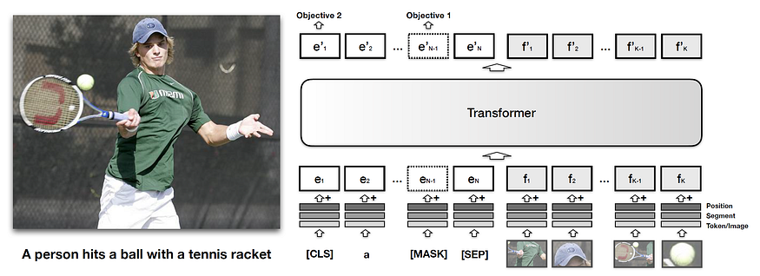
VisualBERT Architecture and Pretraining objectives
Text tokens and visual tokens are concatenated into one sequence and cross-modal interactions are learned through self-attention
VisualBERT is pretrained using:
Masked language modeling with image context
Vision–language matching to determine whether an image and caption correspond
Notes:
https://sh-tsang.medium.com/review-visualbert-a-simple-and-performant-baseline-for-vision-and-language-616ca0da698
Unlike ViLBERT, it does not mask image regions; the image stream is not explicitly reconstructed

Slide 39
Conceptual Captions Dataset
A curated dataset of ~3 million image–caption pairs
Captions are derived from web alt-text but cleaned, filtered, and transformed into more natural-sounding descriptions
Contains high-quality but relatively short captions focusing on what is visually present
Structured dataset but limited in diversity

Slide 40

Conceptual Captions Dataset
Notes:
https://ai.google.com/research/ConceptualCaptions/download

Slide 41
CLIP Contrastive Language-Image Pretraining
Earlier multimodal models (ViLBERT, VisualBERT) combine vision and language inside the Transformer
They depend heavily on region-level object detectors (Faster R-CNN) and specialized multimodal architectures
CLIP introduces a new paradigm: a contrastive dual-encoder model
Two separate encoders, one for images and one for texts
Image-text alignment through a contrastive objective outside the Transformer, not through joint attention
Trained on massive web-scale datasets
CLIP produces a highly general, flexible multimodal representation used for zero-shot classification and retrieval
Notes:
ViLBERT and VisualBERT introduced powerful ways to combine vision and language inside a single multimodal Transformer, enabling deep cross-modal reasoning through co-attention or joint self-attention.
However, these models depend heavily on:
region-based object detectors (like Faster R-CNN),
specialized multimodal architectures, and
relatively limited pretraining datasets.
A breakthrough came with CLIP, which takes a completely different approach.
Instead of merging the modalities early inside one Transformer, CLIP trains separate encoders for images and text, and aligns them only at the level of embeddings — using massive internet-scale data.
This leads to a model that:
does not require object detectors,
does not need a joint multimodal Transformer,
scales to hundreds of millions of image–text pairs,
and learns an extremely powerful shared embedding space.

Slide 42
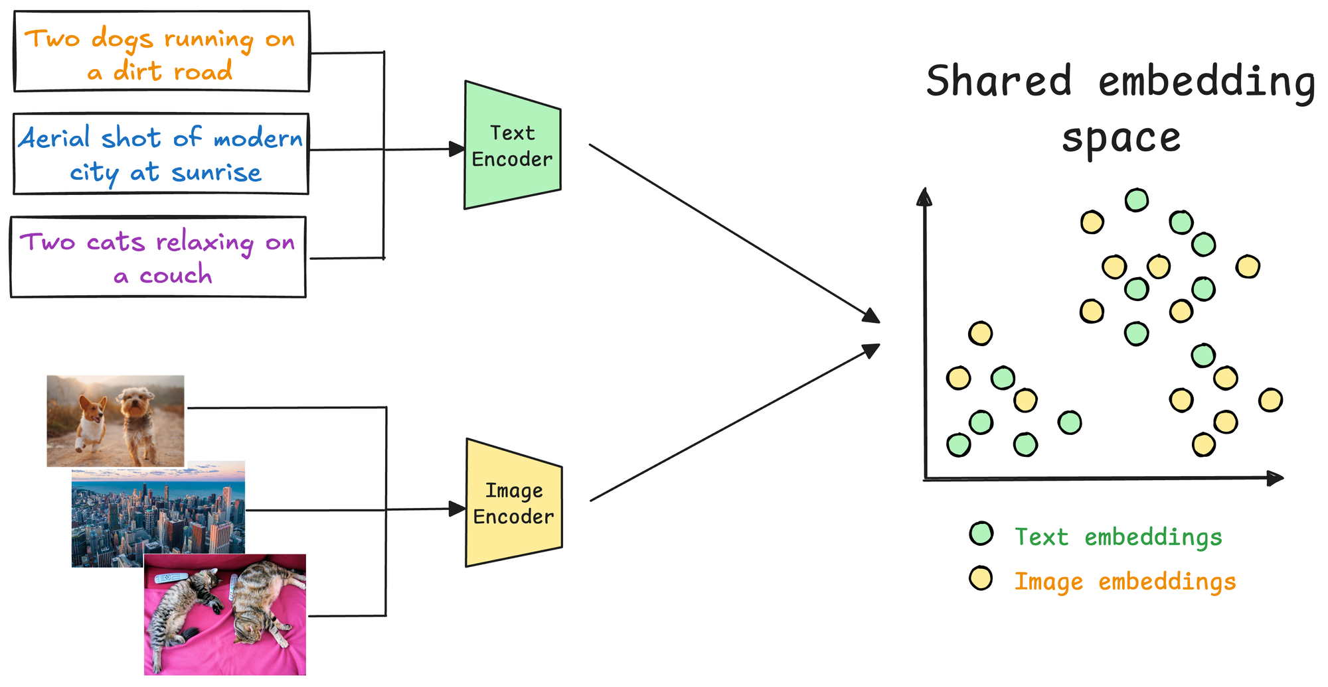
CLIP Dual-encoder
Notes:
Two separate encoders, one for images and one for texts
Image-text alignment not through joint attention inside the transformer, but through a contrastive objective outside the Transformer

Slide 43
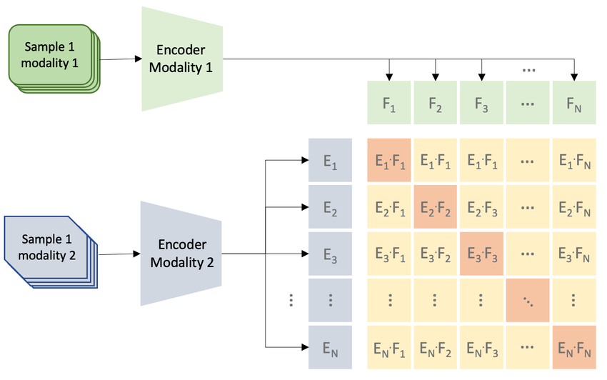
CLIP Contrastive pretraining
Contrastive pretraining trains a model to pull together embeddings of matching pairs (e.g., an image and its caption) and push apart embeddings of non-matching pairs, creating a discriminative and semantically organized multimodal embedding space
Notes:
During contrastive image-text pretraining, a multimodal embedding space is learned by jointly training an image encoder and text encoder to maximize the cosine similarity of the image and text embeddings of the N real pairs in the batch while minimizing the cosine similarity of the embeddings of the N²− N incorrect pairs

Slide 44
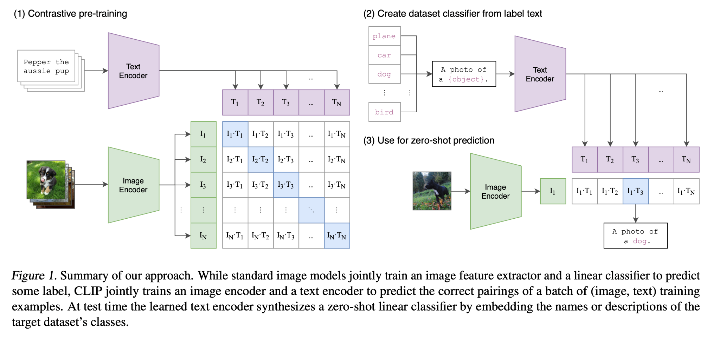
CLIP Contrastive pretraining and Zero-shot prediction
Notes:
CLIP (Contrastive Language–Image Pretraining)
Joint training of an image encoder and a text encoder.
Learns a shared embedding space via contrastive learning.
Excellent for retrieval, classification, zero-shot recognition.

Slide 45
WebImageText Dataset
A massive web-scale dataset gathered by scraping 400 million image–text pairs from the internet
Captions can be messy, noisy, and highly variable (tweets, titles, alt-text, descriptions, comments, etc.)
Extremely diverse in topics, styles, domains, and quality
Not manually cleaned
Notes:
Relies on scale and contrastive learning to overcome noise

Slide 46
BLIP Bootstrapping Language–Image Pretraining
CLIP introduced a powerful idea: Train separate image and text encoders on massive web data using contrastive learning, so that images and captions align in a shared embedding space
CLIP is excellent at multimodal tasks that require image understanding such as retrieval, zero-shot classification and image-text matching
CLIP cannot generate language about images, so it cannot perform tasks like image captioning or visual question answering
BLIP can understand and generate language about images by fusing visual features into an image-grounded text encoder for cross-modal alignment and using an image-grounded text decoder for captioning
Notes:
Introducing BLIP: Bridging Vision Encoders and Language Models
BLIP (Bootstrapping Language–Image Pretraining) takes a major step beyond CLIP:
1. It connects a vision encoder to a language model (LM).
Unlike CLIP's dual encoders, BLIP introduces:
an image encoder (ViT)
a text decoder capable of generating language (captioning, VQA)
2. It supports both contrastive alignment and generative learning.
→ making it useful for image captioning, VQA, and reasoning, not only retrieval.
3. It performs multimodal pretraining designed for vision + text generation.
BLIP learns:
to match images with text (like CLIP)
to generate text describing images
to answer questions about images
This makes BLIP a foundational model for multimodal generative AI.
⭐ BLIP-2: The Key Innovation Leading to GPT-4V & Gemini
BLIP-2 introduced a breakthrough architecture:
It connects a frozen vision encoder and a frozen large language model (LLM) using a lightweight Q-former.
This Q-former:
extracts meaningful visual tokens
maps them into the LLM’s embedding space
lets the LLM “understand” visual content
without retraining the LLM or heavy computation
This solved the biggest challenge of multimodal LLMs:
“How do we efficiently make an LLM see?”
BLIP-2 showed that you can bolt vision onto an LLM without retraining the LLM at all.
⭐ How BLIP-2 Inspired GPT-4V and Gemini
Modern multimodal LLMs follow the same key idea:
Keep the LLM mostly frozen and add a learned vision interface.
GPT-4V integrates vision by mapping visual embeddings into the LLM’s language space, just like BLIP-2 did.
Gemini goes further by training vision, language, and multimodal components jointly — but still uses the principle of shared embedding space + efficient alignment layers that BLIP-2 pioneered.
In short:
BLIP-2 was the first practical demonstration that vision–language alignment can be achieved without retraining the entire LLM, paving the way for scalable multimodal giant models.
⭐ Slide Version (Compact)
CLIP → BLIP → GPT-4V/Gemini
CLIP: Dual encoders + contrastive learning → great for matching images and text, but not generative.
BLIP: Adds a text decoder and multimodal pretraining → supports captioning, VQA, and reasoning.
BLIP-2: Connects a frozen vision encoder and frozen LLM via a Q-former → efficiently gives LLMs vision.
GPT-4V / Gemini: Extend this paradigm to large-scale multimodal LLMs with integrated vision–language reasoning.

Slide 47
BLIP Architecture
Unimodal Encoders that encode each modality on its own
The image encoder turns the image into patch embeddings
The text encoder turns text into token embeddings
Image-grounded Text Encoder that grounds words in specific parts of the image for understanding
It uses cross-attention so that each text token can look at relevant patches
Image-grounded Text Decoder that grounds words in specific parts of the image for generation
At each step, cross-attention lets the decoder produce captions by looking at the relevant parts of the image as it generates each word
It uses causal or masked self-attention so generation flows left-to-right
Notes:
BLIP’s Core Structure Explained
1. Unimodal Encoders — “Look” and “Read” Separately
BLIP begins by encoding each modality on its own:
The image encoder (usually a Vision Transformer) turns the image into visual embeddings.
The text encoder turns text into token embeddings.
At this stage, no cross-modal interaction happens yet—each encoder specializes in understanding its own input.
2. Image-grounded Text Encoder — “Understand the Text in the Context of the Image”
Once both inputs are encoded, BLIP uses a text encoder that is conditioned on the image:
It uses cross-attention layers so that each text token can look at relevant visual features.
This helps the model understand phrases like “the man riding a bike” by grounding them in specific parts of the image.
3. Image-grounded Text Decoder — “Generate Text About the Image”
Finally, BLIP uses a decoder that generates text conditioned on the image:
It outputs captions or answers to questions.
It uses causal self-attention (like GPT) so generation flows left-to-right.
At each step, cross-attention lets the decoder draw information from the visual features.
Flexible Input Modes
Image-only, text-only, or image + text inputs.
Supports multiple tasks without modifying the architecture.
BLIP’s Architecture unifies contrastive, fusion, and generative modeling in one framework.
Unlike CLIP, BLIP can understand and generate language about images.
Unlike ViLBERT/VisualBERT, it does not require region-based object detectors (uses ViT instead).

Slide 48
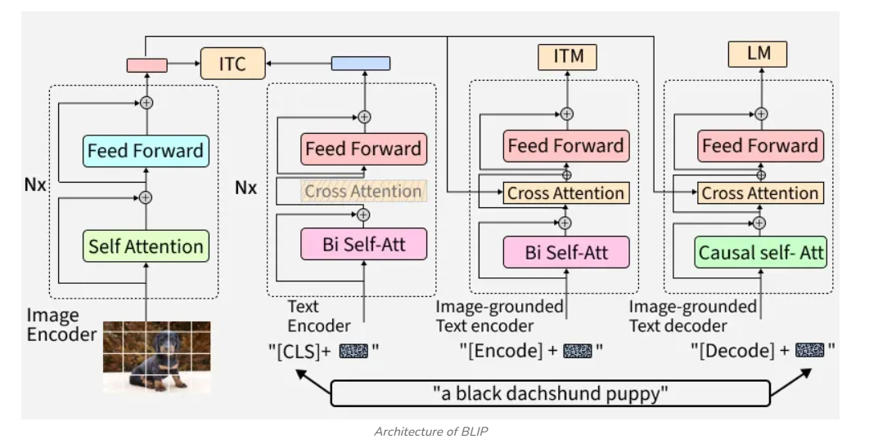
BLIP Architecture
Notes:
BLIP’s Core Structure Explained
1. Unimodal Encoders — “Look” and “Read” Separately
BLIP begins by encoding each modality on its own:
The image encoder (usually a Vision Transformer) turns the image into visual embeddings.
The text encoder turns text into token embeddings.
At this stage, no cross-modal interaction happens yet—each encoder specializes in understanding its own input.
Conceptually: The model first sees the image and reads the text independently.
2. Image-grounded Text Encoder — “Understand the Text in the Context of the Image”
Once both inputs are encoded, BLIP uses a text encoder that is conditioned on the image:
It uses cross-attention layers so that each text token can look at relevant visual features.
This helps the model understand phrases like “the man riding a bike” by grounding them in specific parts of the image.
Conceptually: The model now reads the text while looking at the image, linking words to visual regions.
3. Image-grounded Text Decoder — “Generate Text About the Image”
Finally, BLIP uses a decoder that generates text conditioned on the image:
It outputs captions or answers to questions.
It uses causal self-attention (like GPT) so generation flows left-to-right.
At each step, cross-attention lets the decoder draw information from the visual features.
Conceptually: The model now speaks about the image, producing captions or answers by looking at the image as it generates each word.

Slide 49
BLIP Pretraining objectives
BLIP introduces three complementary pretraining objectives, enabling both alignment and generation:
Image–Text Contrastive Learning (ITC) which learns a shared embedding space by pulling matched image–text pairs together and pushing mismatched ones apart
Image–Text Matching (ITM) helps the model learn to classify whether a given image and text match which strengthens cross-modal alignment
Image Captioning (LM) through which the model learns to generate a caption conditioned on an image and become good at image-to-text generation
Notes:
BLIP introduces three complementary pretraining objectives, enabling both alignment and generation.
Image–Text Contrastive Learning (ITC)
Similar to CLIP’s contrastive loss.
Pulls matched image–text pairs together; pushes mismatched ones apart.
Learns a shared embedding space.
Image–Text Matching (ITM)
The model learns to classify whether a given image and text match.
Strengthens cross-modal alignment.
Image Captioning (LM)
The model learns to generate a caption conditioned on an image.
Helps it become good at image-to-text generation.

Slide 50
BLIP-2
BLIP can understand and generate text about images, but it cannot easily use existing LLMs because connecting vision to an LLM normally requires expensive retraining
BLIP-2 provides a cheap and efficient way to give an LLM visual understanding without retraining the LLM
It uses a small bridging module that translates visual information into a form an LLM can understand
The LLM stays frozen but can now answer questions about images or describe them
BLIP-2 showed that vision can be added on top of existing LLMs, inspiring models like GPT-4, Gemini, and LLaVA

Slide 51
Exam Info

Slide 52
Exam info (more information will be published on Canvas)
PE challenges (60%)
No retake possible
Exam (40%)
Proctorio-based, closed book, @campus exam!
Max. 2 hours (inclusive)
Question types:
Open questions (15%)
Multiple choice, fill-in-the-blanks, connect the description to the concept (25%)
No correction for guessing

Slide 53


